Slide 1
IDfree GO!
ACTIVATION DIRECTLY FROM
KANTAR MEDIA TGI
IN A CUP OF COFFEE’S TIME
KANTAR MEDIA • IDFREE
GLOBAL DATA RESOURCES

Slide 2
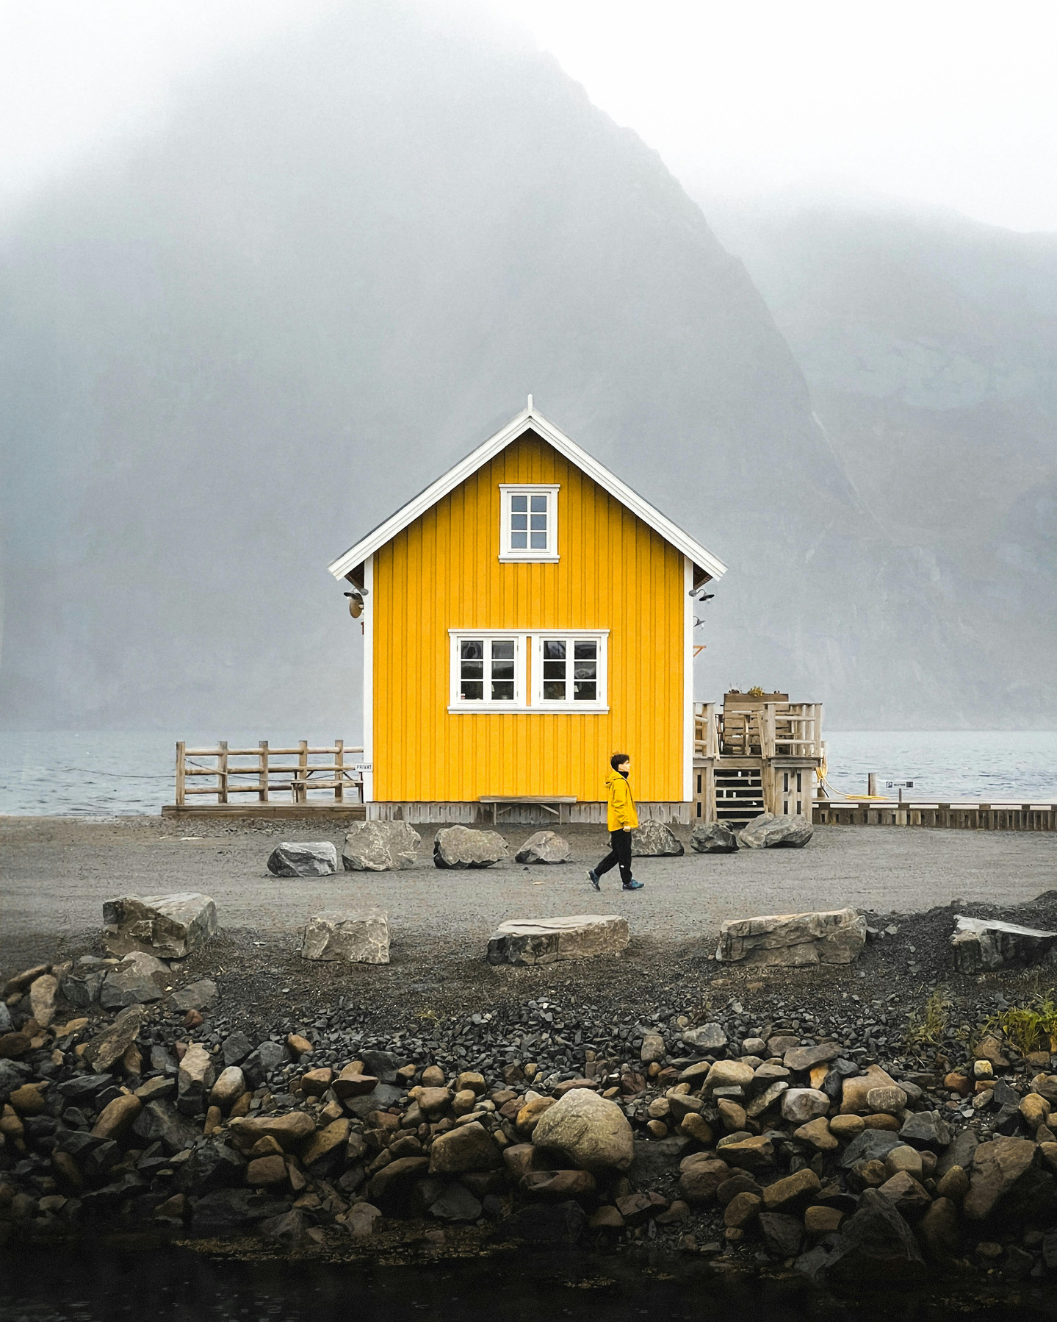
Introduction
Before IDfree GO!, digital advertising was a complicated affair.
LIMITED AUDIENCE CONTROL
Traditional programmatic buying often involves simplified audience categories. This meant advertisers lost control over the nuances of their target audience.
SLOW ACTIVATION TIMES
Waiting for cookies to populate and sync across platforms could take weeks, delaying campaign launches.
RESTRICTED DATA COMBINATIONS
Previously, combining different data points for precise audience targeting was difficult.
IDfree GO! tackles the limitations of traditional programmatic advertising.

Slide 3
Direct Kantar Media Integration
IDfree GO!
Revolutionizes Activation
IDfree GO!
Tackles Traditional Limitations
Instant Activation: Launch campaigns in minutes, not weeks, with seamless activation across all major platforms.
Direct Kantar Media Integration: Leverage Kantar Media's TGI data for deep audience insights, which leads to more effective media planning and buying decisions.
Privacy-Focused Targeting: IDfree GO! prioritises user privacy. Kantar Media's TGI data is fully GDPR-compliant, with user consent and rigorous quality assurance measures.
Granular Control: Precise targeting based on detailed audience attributes.
Lightning-Fast Activation: Streamlined processes for rapid campaign launches.
Powerful Insights: Leverage Kantar Media's trusted consumer data for superior audience understanding.

Slide 4
Building Bridges
IDfree GO! bridges the gap between deep audience understanding and efficient campaign activation in the Nordics (Denmark, Finland, Norway, and Sweden).
LEVERAGE KANTAR MEDIA'S TGI DATA
Gain rich consumer insights directly from Kantar Media's TGI research in the Nordics.
Uncover valuable details about your target audience's demographics, behaviours, and media consumption habits.
SEAMLESS ACTIVATION ACROSS CHANNELS
Utilize these insights to activate the same precisely defined audience across all major marketing channels and platforms, including social media.
IDfree GO! streamlines the process, eliminating the need to translate insights into different targeting formats for each platform.
IDfree GO! empowers data-driven marketing in the Nordics.

Slide 5
Advertisers. Agencies. Publishers.
IDfree GO! Empowers Advertisers, Agencies, and Publishers.
This innovative solution is specifically designed to benefit various players in the Nordic advertising landscape:
ADVERTISERS
Advertisers: Reach your target audience precisely and efficiently across all platforms.
AGENCIES
Agencies: Deliver exceptional campaign results for your clients with IDfree GO!'s streamlined activation.
PUBLISHERS
Publishers: Attract valuable advertisers by offering access to precisely targeted audiences.
IDfree GO! eliminates the need to translate insights into different targeting formats for each platform.

Slide 6
Data-Driven
Insight
→ IN ESSENCE
IDfree GO! empowers data-driven marketing in the Nordics by enabling efficient activation directly from comprehensive audience insights by Kantar Media's TGI.
Seamless
Scalable
Safe
Your audiences are directly transferred from strategy and planning to the digital trading desk.
Access your target group in minutes through a self-service integration in the TGI platform.
Your target groups can be activated on major platforms like Facebook, Google, Snap, YouTube, etc.
The model is built on a scalable method that gives you sufficient reach.
You can adjust it to campaign goals.
Your audiences are created on privacy by design, not touching any kind of PII or sensitive information.
No worries about any audience affected by the next ITP change or if Google excludes anything.
This is a future-proof model!

Slide 7
What’s Next?
Please reach out to GDR’s Nordic team through:
Gunnar Kihl: gunnar.kihl@globaldataresources.io
Göran Eklöf: goran@globaldataresources.io
Download IDfree GO! PDF
globaldataresources.io
Subscribe to our newsletter idfree insider to keep up with news about IDfree GO!

