Slide 1
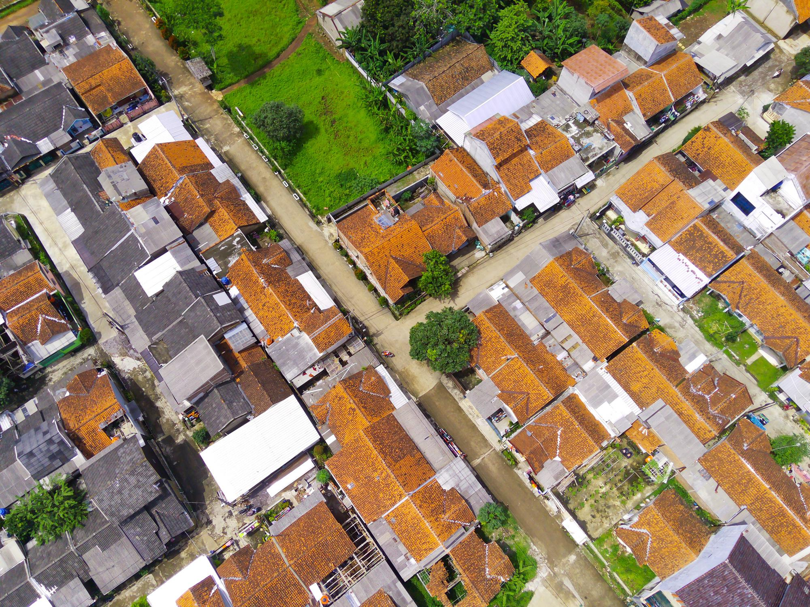

Geo
Demographical
Targeting
GLOBALDATARESOURCES.IO

Slide 2


About GDR
INSIGHTS-DRIVEN TARGETING
  Global Data Resources (GDR) is a pioneering provider of geo-demographic targeting to advertisers, agencies, publishers, and tech vendors.
  In collaboration with data partners and governmental statistical offices, GDR offers insights on lifestyle, life phases, income, family type, dwelling, savings and more.
  35 markets. Covering over 1,8 Billion people across EMEA, Asia, Australia, and the Americas.
GEO-TARGETING
The output is geographical targeting, which ensures that no private data is used as input or output.
When applied to campaigns, we do not see or store cookies or user IDs.
"We’re very pleased to collaborate with GDR which is widely recognized for its footprint on enriched audience data, and to provide marketers with a 100% independent alternative to the existing targeting offerings."
- Pierce Cook-Anderson, Managing Director Northern Europe, Equativ

Slide 3






Our Unique Approach
EMPOWERING MODERN MARKETERS
Neighbourhoods Matter
Consumer Insights
Geographical clusters of relevant consumer preferences-patterns.
Official statistics data enriched with lifestyle segmentation.
No Tracking Individuals
True Omnichannel
Audiences are built without third-party cookie tracking. Geo is key.
Audiences work in all DSPs, SSPs, and SoMe platforms.
Instant Activation
Unified Global Taxonomy
The targeting tool IDfree allows activation of the same audience.
Access to 120 pre-built audiences reaching across 35 countries.

Slide 4

What Countries Do We Cover?
MARKET-LEADING CONSUMER DATA FOR EMEA, APAC, AND THE AMERICAS
We offer consumer classification data and interest data for 35 markets, covering over 1,8 Billion people across EMEA, Asia, Australia, and the Americas.

Slide 5
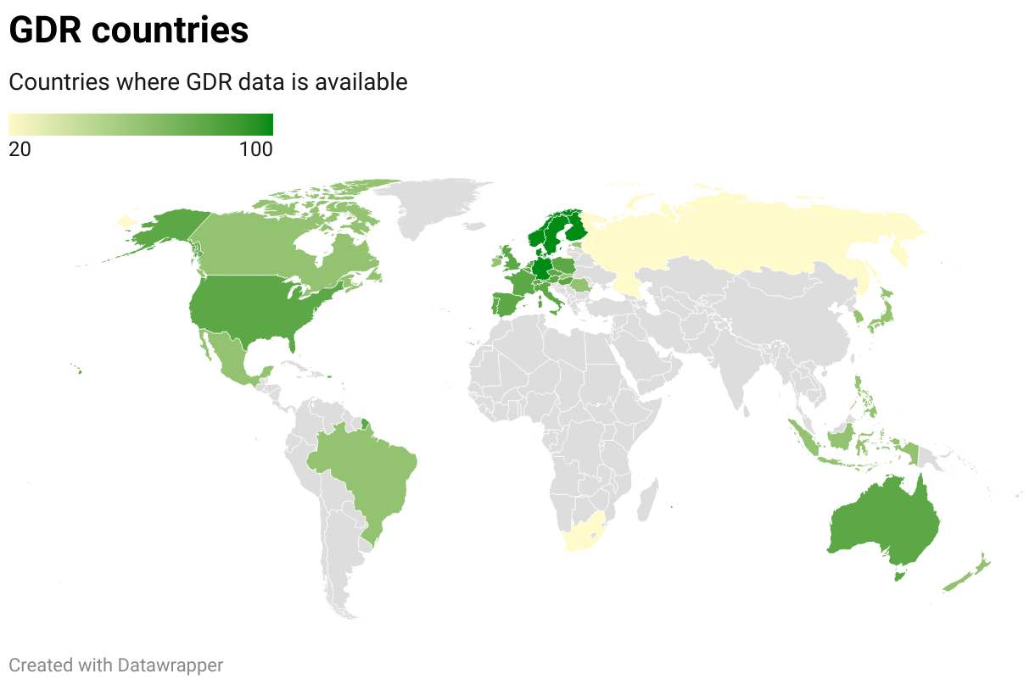
On-demand Ready
Click to see the map
in a webpage.

Slide 6
Countries List
READY
Australia
Austria
Belgium
Czech Republic
Denmark
Finland
France
Germany
Italy
Japan
Netherlands
Norway
Poland
Portugal
Spain
Sweden
Switzerland
United Kingdom
United States
ON DEMAND
Brazil
Canada
Estonia
Hong Kong
Hungary
Indonesia
Ireland
Mexico
New Zealand
Philippines
Romania
Russia
Singapore
Slovakia
South Africa
South Korea
On-demand Ready

Slide 7
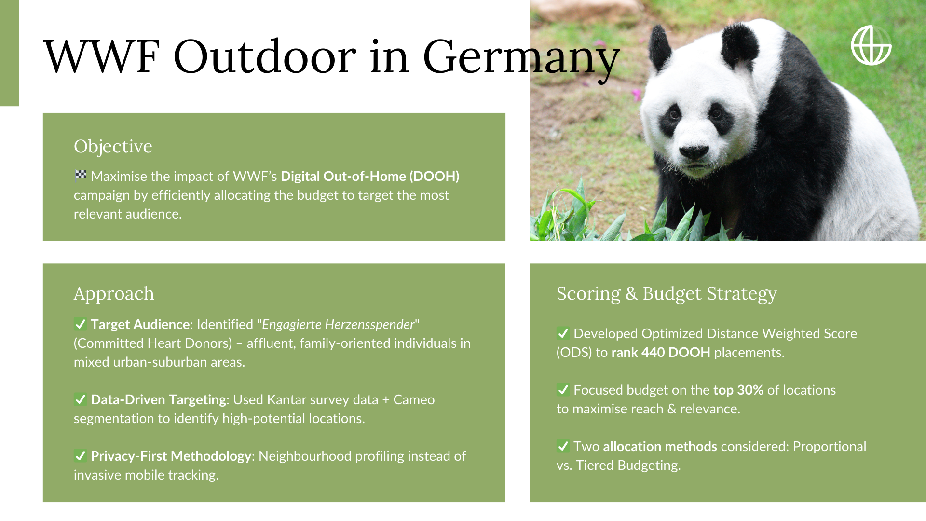

Slide 8



WWF Outdoor in Germany
EXAMPLE
High-scoring locations (e.g., Plochingen
in Baden-Württemberg) had 4x more impact than low-scoring ones.
2020
2021
EFFICIENT BUDGET USE
DATA-BACKED DECISION MAKING
FUTURE IMPLICATIONS
€750,000 allocated using ODS model, prioritizing placements near the target group.
Ranked all 440 placements with a
data-driven scoring model to maximise WWF's outreach.
✅ Scalable & adaptable for future DOOH campaigns.
✅ Privacy-compliant geo-demographic targeting instead of tracking individuals.
✅ Optimized budget ensures high engagement and conversion rates.

Slide 9
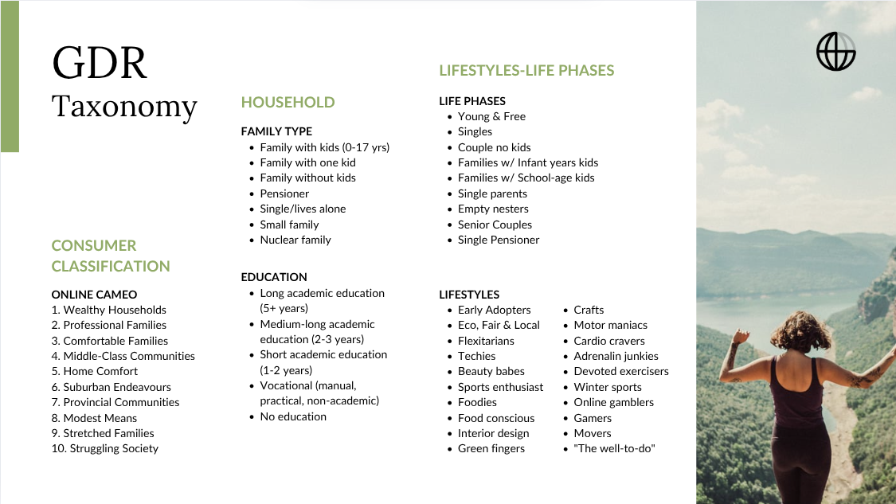

Slide 10
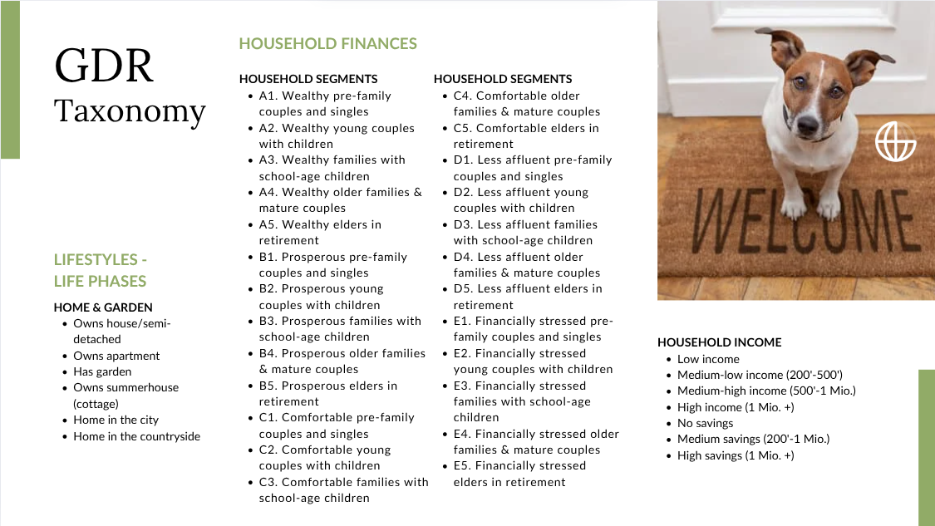

Slide 11
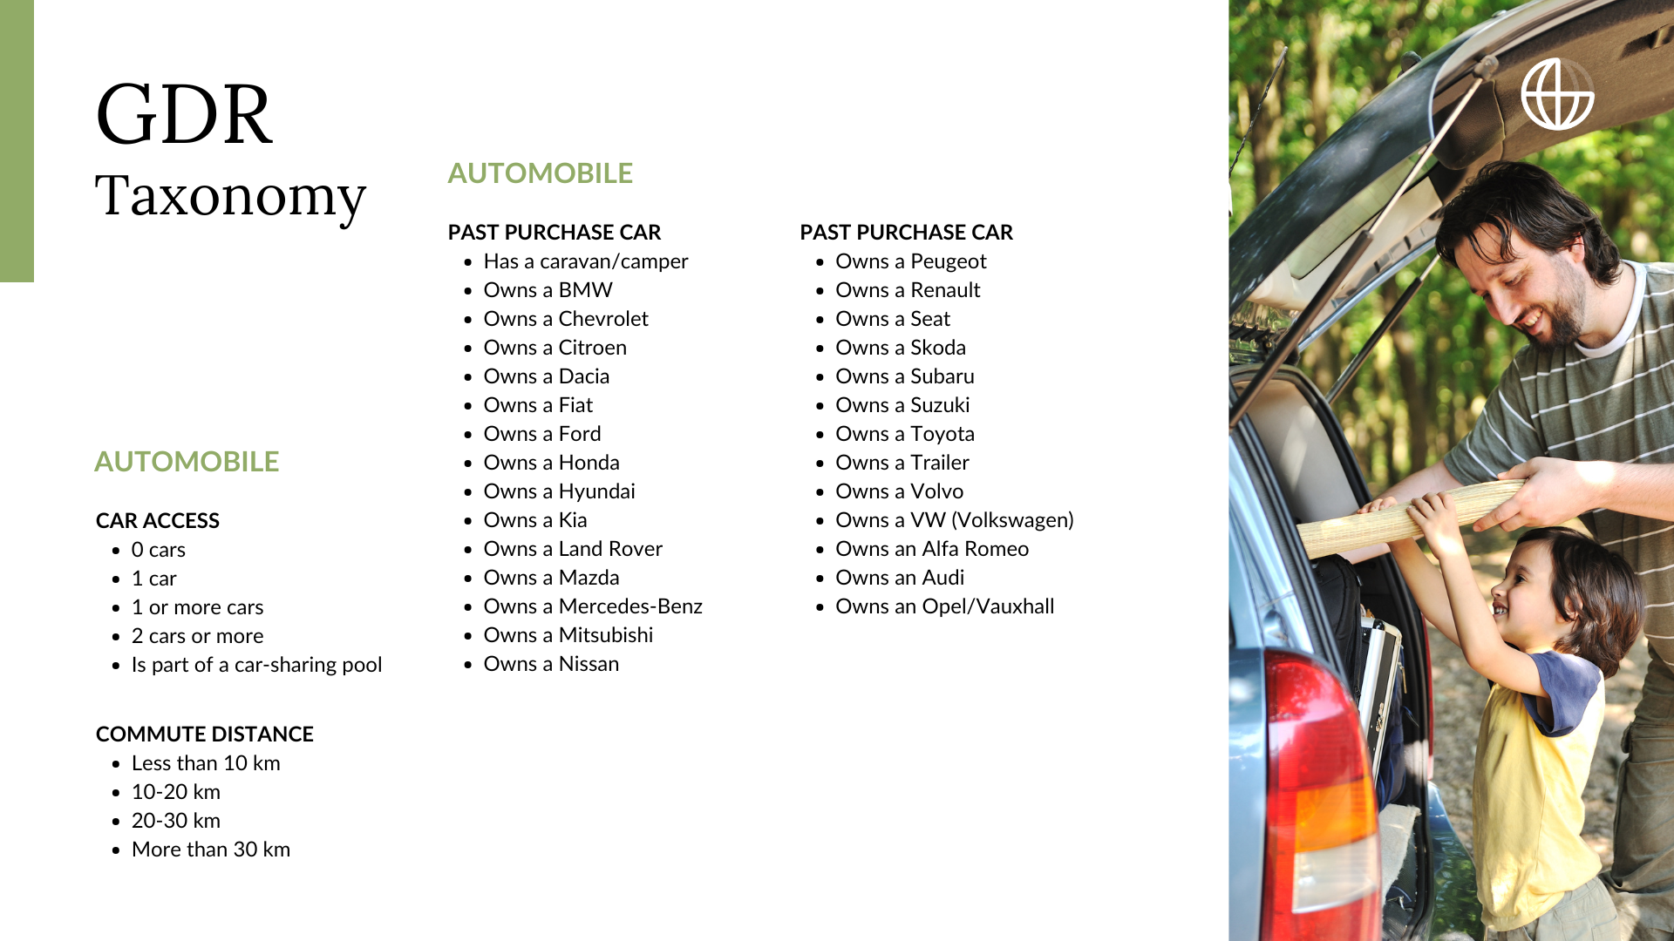

Slide 12
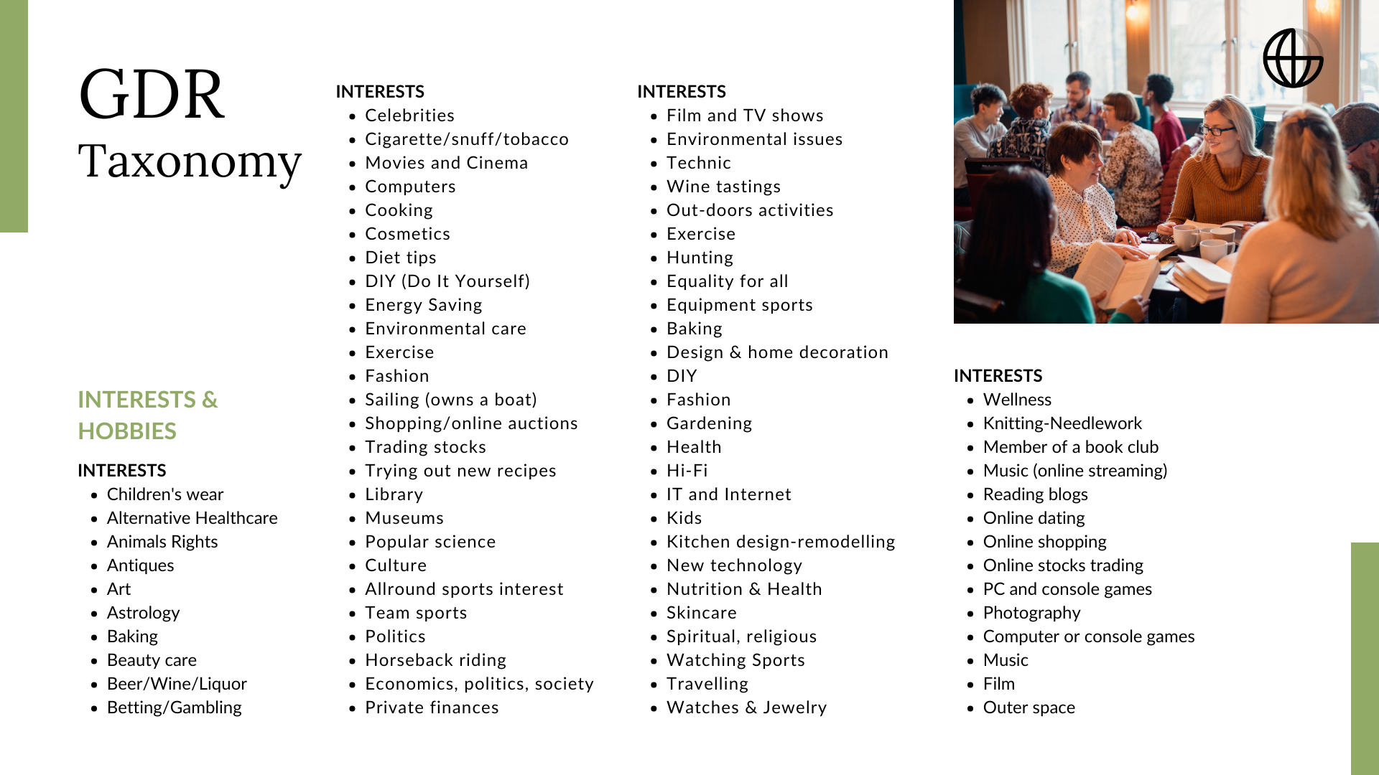

Slide 13
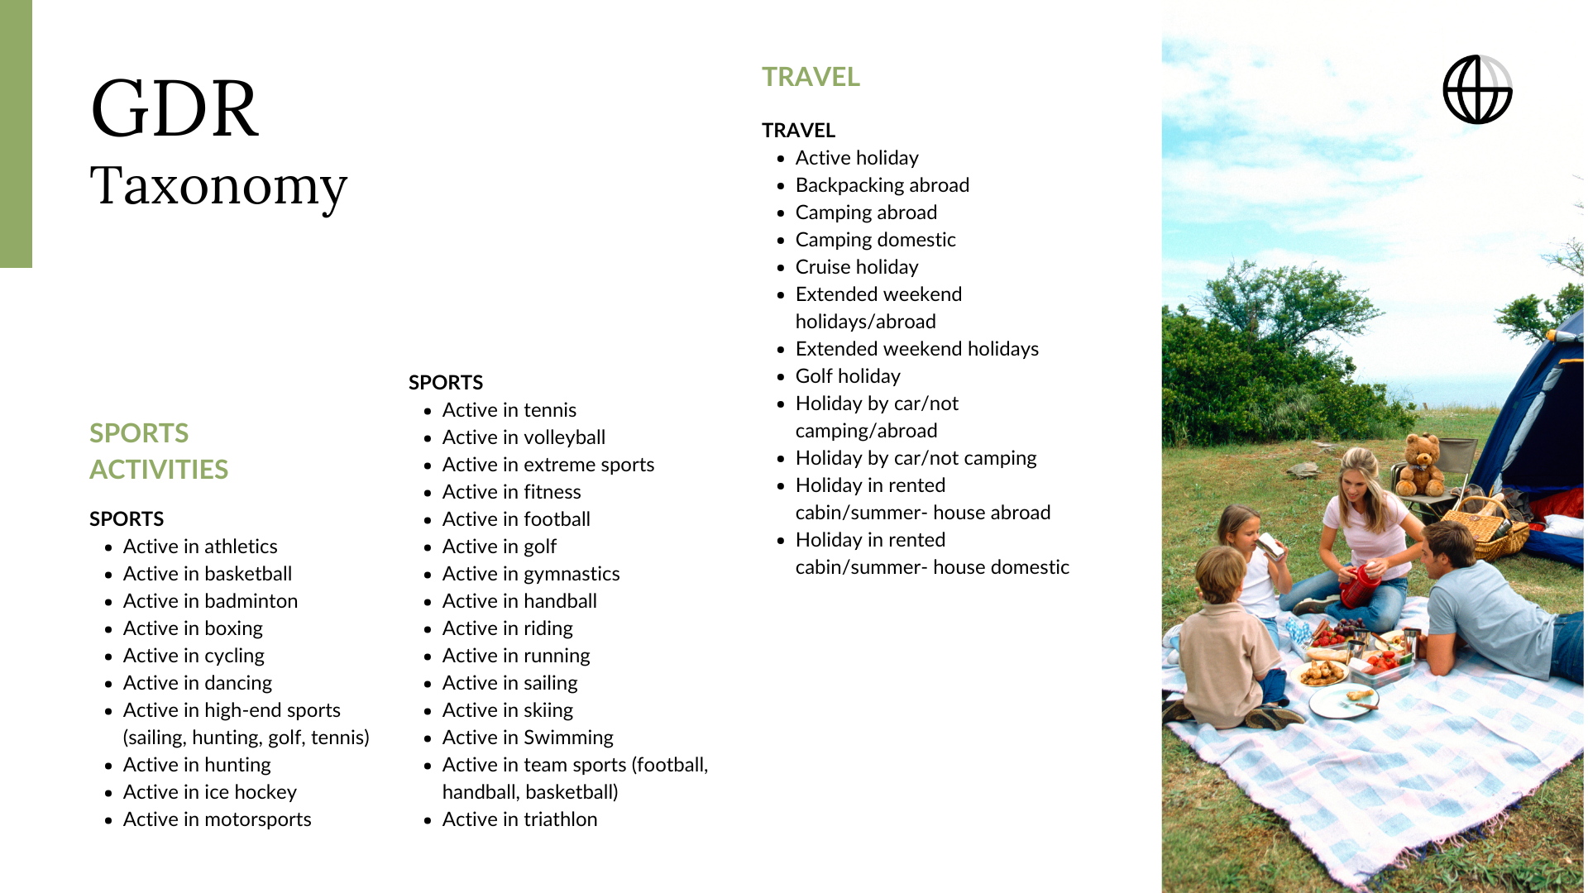

Slide 14
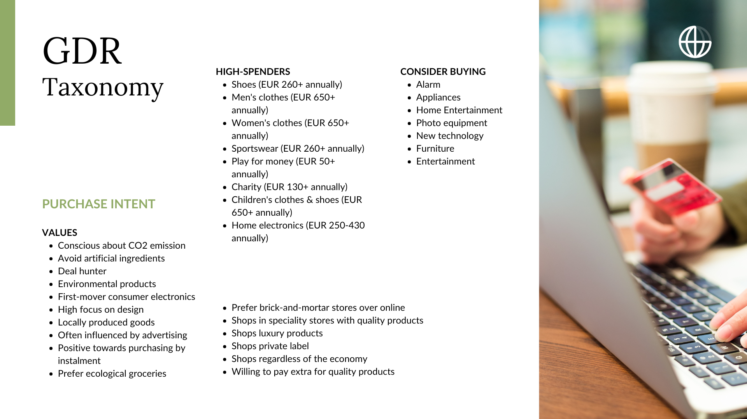

Slide 15


Slide 16



Thank You
FOR YOUR INTEREST IN GDR
We are confident that together we can achieve significant results. Let’s discuss how we can make that happen.
globaldataresources.io
gunnar.kihl@globaldataresources.io

