Slide 1
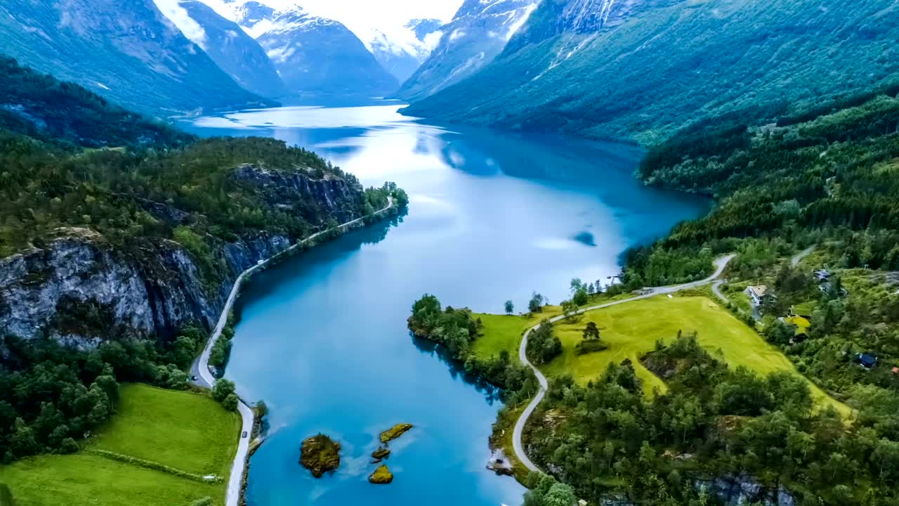
Unlock
Insights-Driven Targeting In
NORWAY
SWEDEN
DENMARK
FINLAND
Notes:
Den er fino
NDR
IPG/ION
Magical Mosaic
Lifestyles matter (3 women)
What can we use that for
- Brief
- Hotspots
- Zoom in
- Dead Spots
- LL file
- Or IDFree (I will get back to that)
Unique understanding
4 products
IDfree -custom audience activation in the time it takes to drink coffee
Built, validate activate (video of slider)
Audience lists
Questions
Thank you

Slide 2
Our data and usage comply with GDPR
and local privacy regulations.
Nordic Data Resources is the largest provider of privacy-safe online ad targeting in the Nordics.
DESCRIPTION
Notes:
Slide 1: NDR – Who/What Are We?
Heading:
"NDR: Pioneers in Data-Driven Nordic Marketing"
Text for the Slide:
"Discover NDR - Your Nordic partner in insightful, ethical, and impactful data-driven marketing solutions."
Speaker Notes:
Story Behind the Slide: Begin by introducing Nordic Data Resources (NDR) as a leader in the field of data-driven marketing in the Nordic region. Emphasize the company's pioneering role in leveraging data ethically and effectively to create marketing strategies that are not only results-oriented but also privacy-compliant.
Highlight NDR's unique approach to understanding consumer behavior through advanced data analytics. This approach focuses on geolocation data and lifestyle-based segmentation, avoiding reliance on invasive tracking methods like third-party cookies.
Mention the significance of NDR's solutions in today's fast-evolving digital landscape, where data privacy concerns are paramount. This positions NDR as a forward-thinking and responsible player in the marketing industry.
Conclude this slide by setting the stage for the rest of the presentation, which will delve deeper into NDR's methods, philosophy, partnerships, and how they translate insights into actionable strategies for their clients. This introduction should create a solid foundation for understanding the value and distinctiveness of NDR in the realm of data-driven marketing.

Slide 3
Long-Term Partnerships
Notes:
Heading:
"Four Years of Data Excellence with IPG MediaBrands"
Text for the Slide:
"Marking four transformative years with IPG MediaBrands, NDR has been pivotal in enriching their data landscape. As a primary data partner, we've granted access to over 2,000 meticulously curated standard audiences, unfolding new dimensions in data-driven strategies across the Nordics."
Heading:
"InsightOne & NDR: Synergizing Mosaic for Targeted Impact"
Text for the Slide:
"In a groundbreaking alliance, NDR and InsightOne unlock the full potential of Mosaic in the Nordics. As the exclusive online targeting partner, we translate InsightOne’s detailed Mosaic analysis into actionable online audiences, creating a seamless bridge between in-depth analytics and digital targeting."

Slide 4
Our Products: Four Different Datasets
DESCRIPTION
1
Mosaic™
2
Official Statistical Data
on Sociodemographics
Via Insight One, NDR offers the most sophisticated consumer classification on the market. Mosaic™ links online audiences to customer CRM data and is a powerful segmentation tool.
From partners like Insight One and governmental statistical offices, NDR offers data on lifestyle, life phases, income, family type, dwelling, savings and more.
3
ICC
4
ICC
Kantar Interest Data
International Consumer Classification: 12 simple groups that work across Australia, Canada, Denmark, Finland, France, Germany, Italy, Japan, Mexico, Netherlands, New Zealand, Norway, Poland, Portugal, Spain, Sweden, Switzerland, UK, and the USA.
Via our privacy-safe integration with Kantar Media,
NDR offers 444 unique interest and preference audiences. The data set is unified across the 4 Nordic countries in New Nordic Unified Taxonomy (NUNT).
Notes:
Kan vi bytte om på 1 og 2 så Mosaic er nummer 1?

Slide 5
Magical Mosaic™
Mosaic by InsightOne is the backbone in all products and the “currency” for all our data collaborations in the Nordics.

Slide 6
Three women. Same Age.
Very Different Lifestyles.
Lifestyles Matter
JOSEPHIN, 31
Part-time Farmer
Married to André, 35
Two kids, 1 and 3 years old
Farm in the countryside
Part-time accountant
Local community theatre
Own a 2017 Nissan Navara

Slide 7
Three women. Same Age.
Very Different Lifestyles.
Lifestyles Matter
JOSEPHIN, 31
ANNA, 32
Part-time Farmer
Medical Practitioner
Married to André, 35
Two kids, 1 and 3 years old
Farm in the countryside
Part-time accountant
Local community theatre
Own a 2017 Nissan Navara
Married to Ivan, 41
Pregnant with first child
Lives in a semi-detached house
in the suburbs
Practices yoga and meditation
Own a 2014 Honda CR-V
Saving for an electric car

Slide 8
Three women. Same Age.
Very Different Lifestyles.
Lifestyles Matter
JOSEPHIN, 31
ANNA, 32
JOHANNA, 33
Part-time Farmer
Medical Practitioner
HR Consultant
Married to André, 35
Two kids, 1 and 3 years old
Farm in the countryside
Part-time accountant
Local community theatre
Own a 2017 Nissan Navara
Married to Ivan, 41
Pregnant with first child
Lives in a semi-detached house
in the suburbs
Practices yoga and meditation
Own a 2014 Honda CR-V
Saving for an electric car
Single, no children
Owns a 2-bedroom apartment
Lives and works in the city
Works +50 hours a week
Likes boxing training
No car, own a bicycle
Commutes with the metro

Slide 9
Three women. Same Age.
Very Different Lifestyles.
Lifestyles Matter
JOSEPHIN, 31
ANNA, 32
JOHANNA, 33
Part-time Farmer
Medical Practitioner
HR Consultant
Married to André, 35
Two kids, 1 and 3 years old
Farm in the countryside
Part-time accountant
Local community theatre
Own a 2017 Nissan Navara
Married to Ivan, 41
Pregnant with first child
Lives in a semi-detached house
in the suburbs
Practices yoga and meditation
Own a 2014 Honda CR-V
Saving for an electric car
Single, no children
Owns a 2-bedroom apartment
Lives and works in the city
Works +50 hours a week
Likes boxing training
No car, own a bicycle
Commutes with the metro

Slide 10
What is
the point?
How can WE
use this?

Slide 11
Brief
Upper middle-class families with 1-2 children driving a Volvo and are interested in tennis.

Slide 12
HOTSPOTS
We can pinpoint hotspots with a high concentration of specific lifestyles.

Slide 13
Here is a closeup of Bergen for audience X.
HOTSPOTS

Slide 14
DEAD SPOTS
We can also flip-the-script and pinpoint dead spots with a low concentration
of specific lifestyles.

Slide 15
How do we use this
It sounds
difficult
time-consuming
and technical

Slide 16
How do we use this
It sounds
difficult
time-consuming
and technical
It’s
Not!

Slide 17
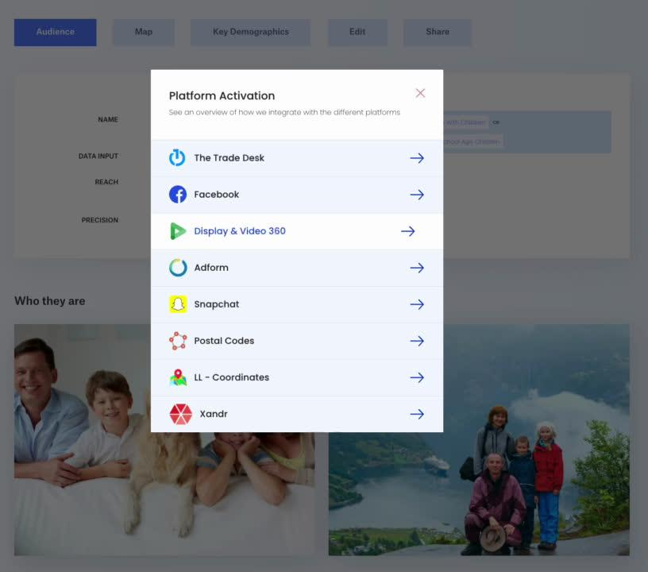
Our IDFree tool has direct integrations to (almost) all major DSPs and platforms.

Slide 18
Just download the codes and upload using our online guides.
No API?

Slide 19
Phasing out
third-party cookies:
No tracking
Limited targeting
Legal issues
Let's talk about IDFree!

Slide 20
Build. Validate. Activate.
In IDFree, standard and Custom Audiences can
be built, validated, and activated in minutes
- not days or weeks!
Notes:
Fino

Slide 21
IDFree lets you build, validate, and control the reach/affinity.

Slide 22
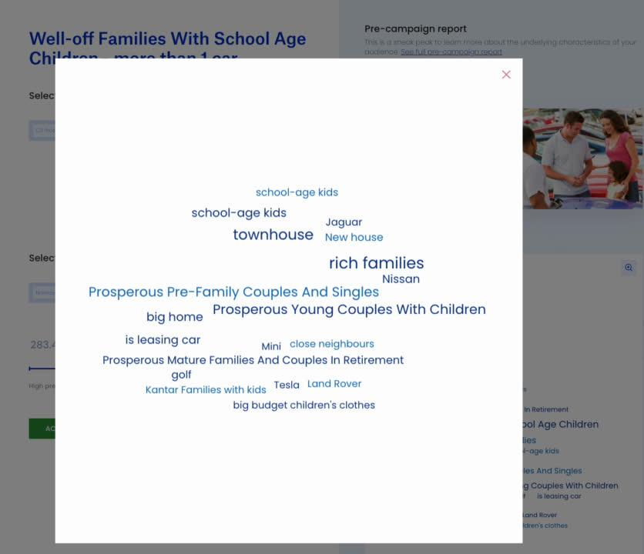
IDFree lets you build, validate, and control the reach/affinity.

Slide 23
IDFree lets you build, validate, and control the reach/affinity.

Slide 24
IDFree Targeting: No cookies.
No tracking. Just insights and speed!
IDFree.com is built to respect privacy and
enable users to build, validate, and activate
in the time it takes to
have a cup of coffee.

Slide 25
The lowest partner price in the marked
Negotiating a possible all-you-can-eat
Close sales support
WHAT IS IN IT FOR US?

Slide 26
Our Unique Understanding
Neighbourhoods Matter
Consumer Insights
Geographical clusters of relevant consumer preferences-patterns.
Official statistics data enriched with lifestyle segmentation.
No Tracking Individuals
True Omnichannel
Audiences are built without third-party cookie tracking. Geo is key.
Audiences work in all DSPs, SSPs, and SoMe platforms.
Instant Activation
Unified Nordic Taxonomy
Partnership w/ IDFree.com allows activation of the same audience.
Access to 444 pre-built audiences reaching across 4 countries.
Notes:
Den er fin

Slide 27
Nordic Audience Lists
Find all the audience lists here:
nordicdataresources.com/audiencelists
2.000+ audiences across the 4 Nordic countries
Notes:
den er fin

Slide 28
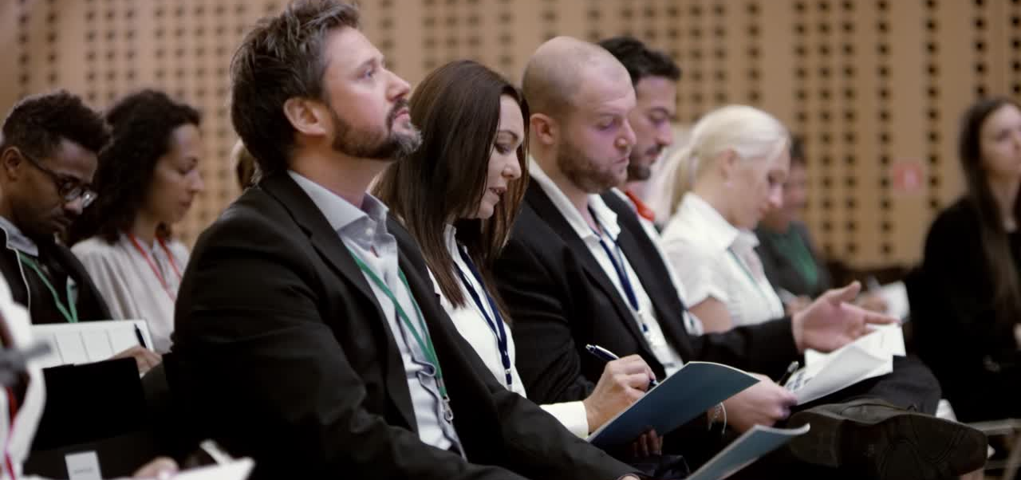
Questions?
Please feel free to ask us specific questions
and/or to elaborate on our presentation.
nordicdataresources.com/faq
Notes:
den er fin

Slide 29
Thank You
For Your Attention
nordicdataresources.com/contact
VP Partnerships and Country Manager
Managing
Director
GÖRAN EKLÖF
GUNNAR KIHL
+46 70 86 79 178
goran.eklof@
nordicdataresources.com
+47 40 55 07 93
gunnar.kihl@
nordicdataresources.com
Notes:
den er fin

