Slide 1


TRANSFORM YOUR DIGITAL INVENTORY WITH
GDR'S CUTTING-EDGE GEO-INTELLIGENT
TARGETING SOLUTIONS.
Unlocking the Value of Your
Inventory with Geo-Intelligent
Targeting
GLOBAL DATA RESOURCES

Slide 2






ABOUT GDR
PRIVACY PIONEER
Global Data Resources (GDR) is a pioneer in privacy-compliant audience targeting solutions.
We help publishers and brands navigate the cookieless future with innovative geo-intelligent technology.
GLOBAL REACH
PRIVACY-FIRST
Coverage in 32 markets with localised insights.
Targeting without cookies or device IDs.
REVENUE GROWTH
PARTNER SUCCESS
Average 40% increase in advertising yield.
Trusted by leading publishers like RTL AdAlliance and platforms worldwide.

Slide 3





OVERVIEW
STANDARD TAXONOMY LICENSING
Access hundreds of pre-built audience segments ready to activate across your entire inventory. Enhance your sales offerings with data-enriched packages.
IDFREE GO! – RESEARCH ACTIVATION
Seamlessly connect agency research tools with your inventory. Enable agencies to activate their defined segments directly on your platforms.
Unlock New Revenue
Empower both direct and programmatic sales teams with high-value targeting capabilities. Increase CPMs with premium audience packages.

Slide 4




STANDARD TAXONOMY LICENSING
350+
100%
20-40%
SEGMENTS PER COUNTRY
GDPR
COMPLIANT
CPM
BOOST
PRE-BUILT AUDIENCE SEGMENTS READY FOR IMMEDIATE ACTIVATION.
NO COOKIES OR DEVICE IDS REQUIRED.
TYPICAL LIFT WITH DATA-DRIVEN PACKAGES.

Slide 5





IDFREE GO! RESEARCH ACTIVATION
EXPANDED REVENUE: UNLOCK NEW AGENCY BUDGETS BY ENABLING THEIR PREFERRED PLANNING TOOLS TO CONNECT WITH YOUR PLATFORMS.
KANTAR
MEDIA
TOOLS
DIRECT EXPORT
Direct export from Kantar Media tools like Orvesto Konsument (SE), Index Danmark (DK), Forbruker & Media (NO), and Mind (FI).
SEAMLESS CONNECTION
IDFREE GO! INTEGRATION
Seamless connection between research insights and your digital inventory. Anything you build directly into your ad server or SSP.
DIRECT
ACTIVATION
MARKET-APPROVED
Market-approved consumer-centric strategies go beyond basic demographics, creating higher-value audience segments.

Slide 6






CUSTOM BUILD
Create bespoke audience segments for specific campaigns.
CUSTOM
BUILD
LAUNCH
Implement segments
across your inventory.
LAUNCH
OPTIMIZE
Refine segments based on performance data.
BONUS
ACCESS:
IDFREE.COM
OPTIMIZE
MONETIZE
MONETIZE
Package custom audiences for premium sales.

Slide 7




WHAT'S REQUIRED FROM YOU?
AD SERVER &
SSP COMPATIBILITY
INTERNAL SALES
INTEGRATION
WE DELIVER,
YOU DEPLOY
Most platforms already support
geo-targeting capabilities.
Align audience usage with your
existing sales processes.
GDR delivers all audience data in your required format.
Simply verify that your current ad server and SSP configuration can handle our
data format.
Ensure your team understands how
to package and position these new targeting options.
GDR can support your integration and setup needs, billed at €180/hour. Tech help is available, but not included in licensing fees.

Slide 8
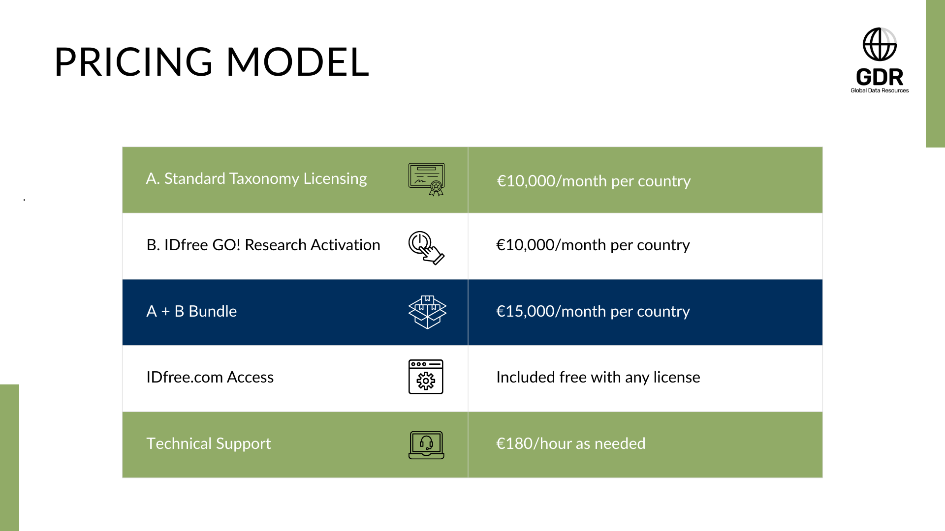

Slide 9






WHY PARTNER
WITH GDR?
UNLIMITED SCALE​
Simple pricing with no impression limits. Deploy across all inventory without additional costs.
FUTURE-PROOF TARGETING​
No reliance on cookies or device IDs. Fully compliant with evolving privacy regulations.​
AGENCY ALIGNMENT​
Directly connect with how media agencies plan. Become an essential partner in their workflow.​
REVENUE GROWTH​
Boost CPMs with value-added targeting. Equip your sales team with powerful data tools.​

