Slide 1


From Research
to Insights
and Activation
GDR - WHERE PERFORMANCE MEETS PRINCIPLES

Slide 2


About GDR
PRIVACY-SAFE
INSIGHTS-DRIVEN TARGETING
  Global Data Resources (GDR) is a pioneering provider of geo-demographic audience data to advertisers, agencies, publishers, and tech vendors.
  In collaboration with data partners and governmental statistical offices, GDR offers insights on lifestyle, life phases, income, family type, dwelling, savings and more.
  35 markets. Covering almost 2,5 billion people across EMEA, Asia, Australia, and the Americas.
GEO-TARGETING
  The output is geographical targeting, which ensures that no private data is used as input or output.
  We do not see or store cookies or user IDs when applied to campaigns.
"We’re very pleased to collaborate with GDR which is widely recognized for its footprint on enriched audience data - and to be able to provide marketers with a 100% independent alternative to the existing targeting offerings."
- Pierce Cook-Anderson, Managing Director Northern Europe, Equativ

Slide 3
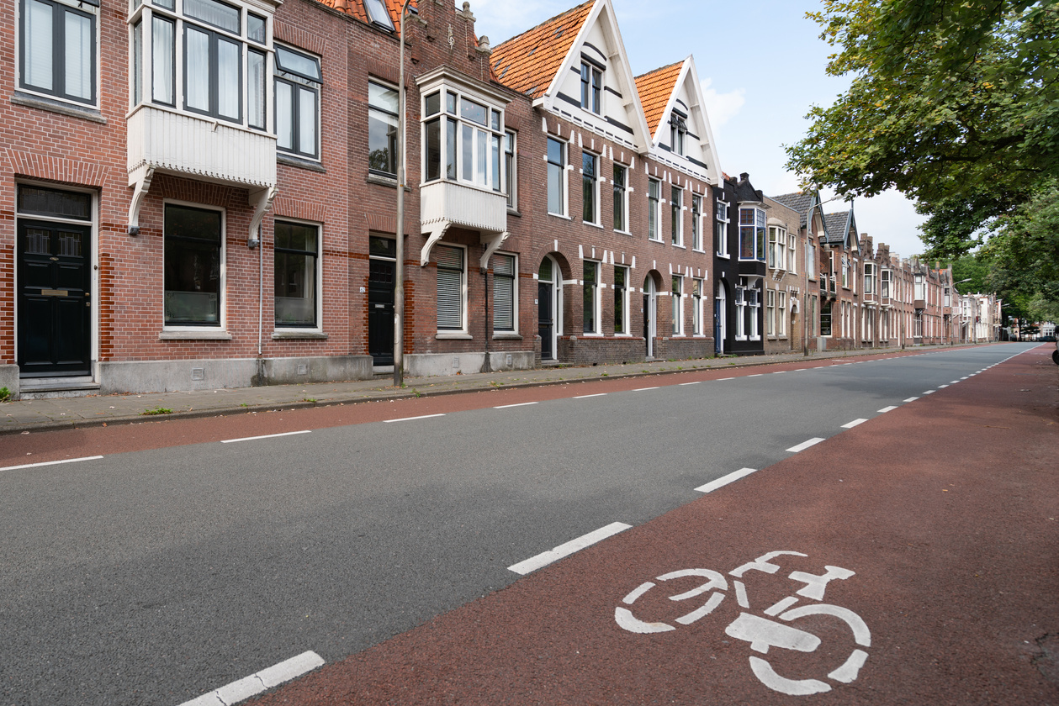





Our Unique Approach
EMPOWERING MODERN MARKETERS
Neighbourhoods Matter
Consumer Insights
Geographical clusters of relevant consumer preferences-patterns.
Official statistics data enriched with lifestyle segmentation.
No Tracking Individuals
True Omnichannel
Audiences are built without third-party cookie tracking. Geo is key.
Audiences work in all DSPs, SSPs, and SoMe platforms.
Instant Activation
Unified Global Taxonomy
The targeting tool IDfree allows activation of the same audience.
Access to 120 pre-built audiences reaching across 35 countries.

Slide 4

What Countries Do We Cover?
MARKET-LEADING CONSUMER DATA FOR EMEA, APAC, AND THE AMERICAS
We offer consumer classification data and interest
data for 35 markets, covering almost 2,5 billion people across EMEA, Asia, Australia, and the Americas.

Slide 5
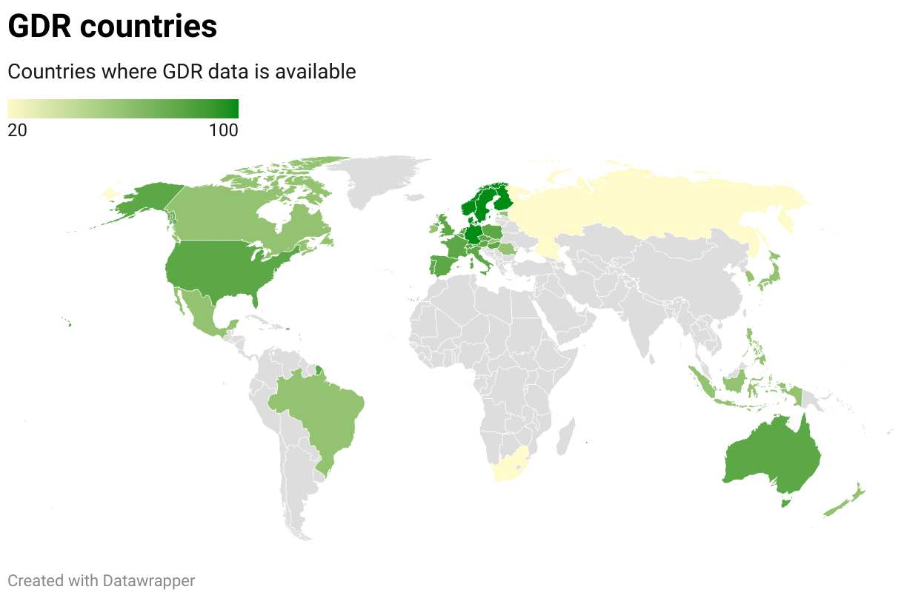
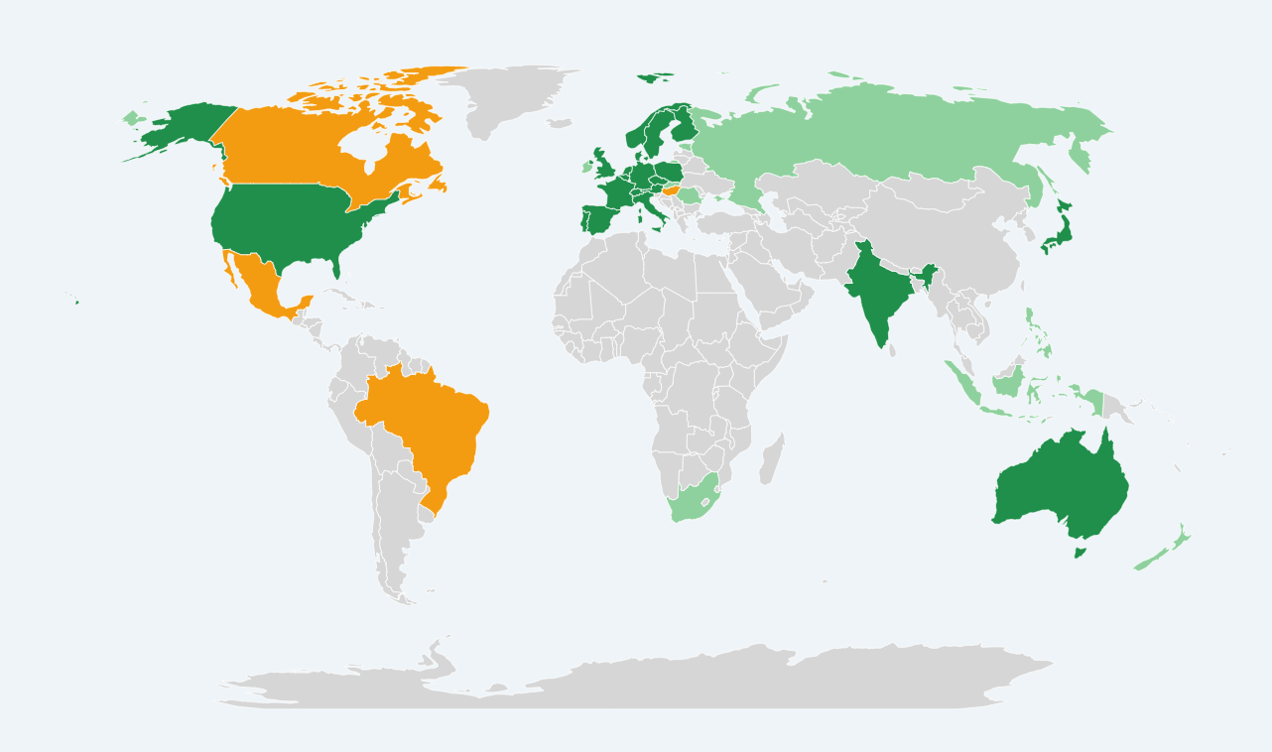
Dark green: Available
Orange: In the pipeline.
Light green: On demand.
Click to see the map in a webpage.

Slide 6
Countries List
READY
Australia
Austria
Belgium
Czech Republic
Denmark
Finland
France
Germany
India
Italy
Japan
Netherlands
Norway
Poland
Portugal
Spain
Sweden
Switzerland
United Kingdom
United States
ON DEMAND
Brazil
Canada
Estonia
Hong Kong
Hungary
Indonesia
Ireland
Mexico
New Zealand
Philippines
Romania
Russia
Singapore
Slovakia
South Africa
South Korea

Slide 7

Unlocking the Power of Survey Research for Digital Activation
CHALLENGES
  Traditional surveys provide valuable consumer insights but often remain disconnected from digital activation.
  Many brands and agencies struggle to turn research into scalable, omnichannel audience targeting.
OUR PROVEN SOLUTION
  We use trusted Geospatial Consumer Segmentation Systems (GCSS) to transform survey-based research into actionable audience segments.
  This enables brands and agencies to identify and reach key audience hotspots through digital advertising.
  A privacy-safe, cookieless approach ensures compliance while delivering highly targeted media activation.

Slide 8

Unlocking the Power of Survey Research for Digital Activation
Seamless Activation & Trusted Integration with Media Agencies
WHAT WE DO FOR PARTNERS
WHAT WE DO FOR PARTNERS
1. Turning Survey Research into Unique Targeting Data:
  We can transform research from any preferred survey partner into actionable digital targeting data.
  Our Geospatial Consumer Segmentation System (GCSS) ensures that no private data is shared with us, keeping the process 100% privacy safe.
  Global survey and insights partners like Kantar Media trust GCSS.
  The data becomes exclusive targeting data for brands and agencies.
2. Delivering Proprietary Targeting Solutions to Agencies:
  Agencies can access exclusive, custom-built audience segments inside their existing internal systems, DSPs, or IDfree.
  We work with any reputable survey partner - seamless integration, no limitations.
  The targeting data is proprietary and unique - no one else can access the same audience segments.

Slide 9



Unlocking the Power of Survey Research for Digital Activation
WHY IT WORKS?
WHY IT MATTERS?
Trusted by leading media agencies.
Cookie-less & Future-Proof: No reliance on third-party cookies or tracking IDs.
Omnichannel Activation: Works across display, video, social, CTV, and DOOH.
Privacy-First & 100% Secure: No private data is exchanged - fully compliant with GDPR.
Exclusive, Proprietary Targeting: Unique segments tailored for agencies.
Omnichannel Activation: Works across digital, video, social, CTV, and Out-of-Home (DOOH).

Slide 10

WWF Outdoor
in Germany
OBJECTIVE
Maximise the impact of WWF’s Digital Out-of-Home (DOOH) campaign by efficiently allocating the budget to target the most relevant audience.
SCORING & BUDGET STRATEGY
APPROACH
✅ Developed Optimized Distance Weighted Score (ODS) to rank 440 DOOH placements.
✅ Focused budget on the top 30% of locations
to maximise reach & relevance.
✅ Two allocation methods considered: Proportional
vs. Tiered Budgeting.
  Target Audience: Identified "Engagierte Herzensspender" (Committed Heart Donors) – affluent, family-oriented individuals in mixed urban-suburban areas.
  Data-Driven Targeting: Used Kantar survey data + Cameo segmentation to identify high-potential locations.
  Privacy-First Methodology: Neighbourhood profiling instead of invasive mobile tracking.

Slide 11



WWF Outdoor
in Germany
EXAMPLE
High-scoring locations (e.g., Plochingen in Baden-Württemberg) had 4 x more impact than
low-scoring ones.
2020
2021
FUTURE IMPLICATIONS
EFFICIENT
BUDGET USE
DATA-BACKED
DECISION MAKING
Scalable & adaptable for future DOOH campaigns.
Privacy-compliant geo-demographic targeting instead of tracking individuals.
Optimised budget ensures high engagement and conversion rates.
€750,000 allocated using ODS model, prioritizing placements near the target group.
Ranked all 440 placements with a
data-driven scoring model to maximise WWF's outreach.

Slide 12

GDR
Taxonomy
LIFESTYLES-LIFE PHASES
HOUSEHOLD
LIFE PHASES
Young & Free
Singles
Couple no kids
Families w/ Infant years kids
Families w/ School-age kids
Single parents
Empty nesters
Senior Couples
Single Pensioner
FAMILY TYPE
  Family with kids (0-17 yrs)
  Family with one kid
  Family without kids
  Pensioner
  Single/lives alone
  Small family
  Nuclear family
CONSUMER
CLASSIFICATION
ONLINE CAMEO
1. Wealthy Households
2. Professional Families
3. Comfortable Families
4. Middle-Class Communities
5. Home Comfort
6. Suburban Endeavours
7. Provincial Communities
8. Modest Means
9. Stretched Families
10. Struggling Society
EDUCATION
  Long academic education (5+ years)
  Medium-long academic education (2-3 years)
  Short academic education (1-2 years)
  Vocational (manual, practical, non-academic)
  No education
LIFESTYLES
Early Adopters
Eco, Fair & Local
Flexitarians
Techies
Beauty babes
Sports enthusiast
Foodies
Food conscious
Interior design
Green fingers
Crafts
Motor maniacs
Cardio cravers
Adrenalin junkies
Devoted exercisers
Winter sports
Online gamblers
Gamers
Movers
"The well-to-do"

Slide 13

GDR
Taxonomy
HOUSEHOLD FINANCES
  C4. Comfortable older families & mature couples
  C5. Comfortable elders in retirement
  D1. Less affluent pre-family couples and singles
  D2. Less affluent young couples with children
  D3. Less affluent families with school-age children
  D4. Less affluent older families & mature couples
  D5. Less affluent elders in retirement
  E1. Financially stressed pre-family couples and singles
  E2. Financially stressed young couples with children
  E3. Financially stressed families with school-age children
  E4. Financially stressed older families & mature couples
  E5. Financially stressed elders in retirement
household segments
A1. Wealthy pre-family couples and singles
A2. Wealthy young couples with children
A3. Wealthy families with school-age children
A4. Wealthy older families & mature couples
A5. Wealthy elders in retirement
B1. Prosperous pre-family couples and singles
B2. Prosperous young couples with children
B3. Prosperous families with school-age children
B4. Prosperous older families & mature couples
B5. Prosperous elders in retirement
C1. Comfortable pre-family couples and singles
C2. Comfortable young couples with children
C3. Comfortable families with school-age children
LIFESTYLES -
LIFE PHASES
HOME & GARDEN
  Owns house/semi-detached
  Owns apartment
  Has garden
  Owns summerhouse (cottage)
  Home in the city
  Home in the countryside
household income
Low income
Medium-low income (200'-500')
Medium-high income (500'-1 Mio.)
High income (1 Mio. +)
No savings
Medium savings (200'-1 Mio.)
High savings (1 Mio. +)

Slide 14

GDR
Taxonomy
AUTOMOBILE
CAR ACCESS
  0 cars
  1 car
  1 or more cars
  2 cars or more
  Is part of a car-sharing pool
past purchase car
Has a caravan/camper
Owns a BMW
Owns a Chevrolet
Owns a Citroen
Owns a Dacia
Owns a Fiat
Owns a Ford
Owns a Honda
Owns a Hyundai
Owns a Kia
Owns a Land Rover
Owns a Mazda
Owns a Mercedes-Benz
Owns a Mitsubishi
Owns a Nissan
Owns a Peugeot
Owns a Renault
Owns a Seat
Owns a Skoda
Owns a Subaru
Owns a Suzuki
Owns a Toyota
Owns a Trailer
Owns a Volvo
Owns a VW (Volkswagen)
Owns an Alfa Romeo
Owns an Audi
Owns an Opel/Vauxhall
commute distance
Less than 10 km
10-20 km
20-30 km
More than 30 km

Slide 15

GDR
Taxonomy
interests
Celebrities
Cigarette/snuff/tobacco
Movies and Cinema
Computers
Cooking
Cosmetics
Diet tips
DIY (Do It Yourself)
Energy Saving
Environmental care
Exercise
Fashion
Sailing (owns a boat)
Shopping/online auctions
Trading stocks
Trying out new recipes
Library
Museums
Popular science
Culture
Allround sports interest
Team sports
Politics
Horseback riding
Economics, politics, society
Private finances
interests
Film and TV shows
Environmental issues
Technic
Wine tastings
Out-doors activities
Exercise
Hunting
Equality for all
Equipment sports
Baking
Design & home decoration
DIY
Fashion
Gardening
Health
Hi-Fi
IT and Internet
Kids
Kitchen design-remodelling
New technology
Nutrition & Health
Skincare
Spiritual, religious
Watching Sports
Travelling
Watches & Jewelry
INTERESTS &
HOBBIES
interests
Wellness
Knitting-Needlework
Member of a book club
Music (online streaming)
Reading blogs
Online dating
Online shopping
Online stocks trading
PC and console games
Photography
Computer or console games
Music
Film
Outer space
interests
Children's wear
Alternative Healthcare
Animals Rights
Antiques
Art
Astrology
Baking
Beauty care
Beer/Wine/Liquor
Betting/Gambling

Slide 16
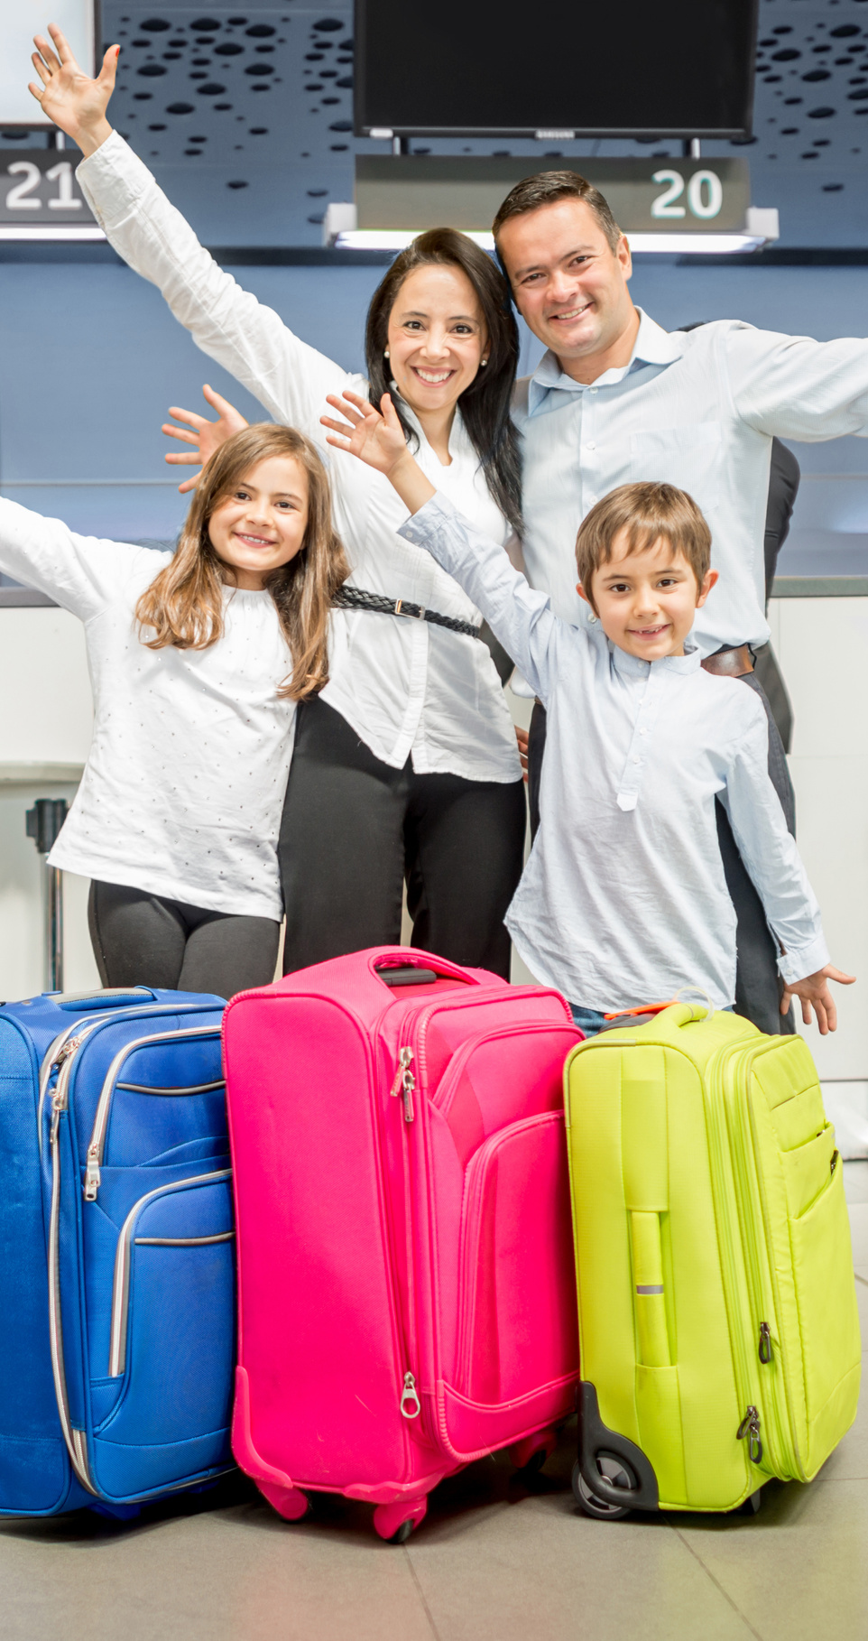
GDR
Taxonomy
TRAVEL
travel
Active holiday
Backpacking abroad
Camping abroad
Camping domestic
Cruise holiday
Extended weekend holidays/abroad
Extended weekend holidays
Golf holiday
Holiday by car/not camping/abroad
Holiday by car/not camping
Holiday in rented cabin/summer- house abroad
Holiday in rented cabin/summer- house domestic
SPORTS
ACTIVITIES
Active in tennis
Active in volleyball
Active in extreme sports
Active in fitness
Active in football
Active in golf
Active in gymnastics
Active in handball
Active in riding
Active in running
Active in sailing
Active in skiing
Active in Swimming
Active in team sports (football, handball, basketball)
Active in triathlon
sports
Active in athletics
Active in basketball
Active in badminton
Active in boxing
Active in cycling
Active in dancing
Active in high-end sports (sailing, hunting, golf, tennis)
Active in hunting
Active in ice hockey
Active in motorsports

Slide 17

GDR
Taxonomy
high-spenders
Shoes (EUR 260+ annually)
Men's clothes (EUR 650+ annually)
Women's clothes (EUR 650+ annually)
Sportswear (EUR 260+ annually)
Play for money (EUR 50+ annually)
Charity (EUR 130+ annually)
Children's clothes & shoes (EUR 650+ annually)
Home electronics (EUR 250-430 annually)
consider buying
Alarm
Appliances
Home Entertainment
Photo equipment
New technology
Furniture
Entertainment
PURCHASE INTENT
values
Conscious about CO2 emission
Avoid artificial ingredients
Deal hunter
Environmental products
First-mover consumer electronics
High focus on design
Locally produced goods
Often influenced by advertising
Positive towards purchasing by instalment
Prefer ecological groceries
Prefer brick-and-mortar stores over online
Shops in speciality stores with quality products
Shops luxury products
Shops private label
Shops regardless of the economy
Willing to pay extra for quality products

Slide 18




Partner Insights
OUR PARTNERS' REVIEW
CHRISTOPHER HERNANDEZ
INGVAR SANDVIK
Managing Director, Nordics,
Matterkind
Marketing & Innovation Director, Kantar Media
Matterkind is driven by purposeful marketing. By introducing targeting with privacy-safe audience data, we are fully aligned with our values of using ethically sourced data to strive to benefit brands and consumers alike.
As a born privacy-first solution, the IDfree targeting platform gives marketers new communication and targeting opportunities in the post-cookie ad world. A world where understanding and reaching audiences without collecting any private data is essential.

Slide 19



Thank You
FOR YOUR INTEREST IN GDR
We are confident that together we can achieve significant results. Let’s discuss how we can make that happen.
globaldataresources.io
gunnar.kihl@globaldataresources.io

